Slide 1
Quiz 1.1 for chapter I
The difference and connection between crystallography and mineralogy;
List crystals and non-crystals in nature and life, at least 3 in each category.
Please give the space lattices of the patterns below
What’s the reason for you to choose the current major?
d1
d2
d2
d1

Slide 2
Chap2 the formation of crystals
The paths for the formation of crystals
The formation of crystalline nuclei (conditions and energy changes)
Models and theories of crystal growth
External factors affecting crystal growth
Artificial crystal growth techniques in industry

Slide 3
I、Three paths toward crystal
From gas to crystal;
From liquid to crystal;
From solid to crystal.

Slide 4
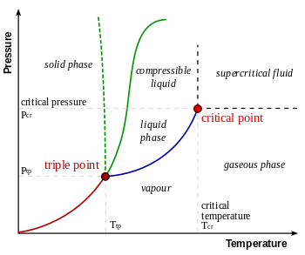
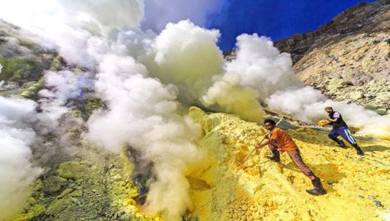
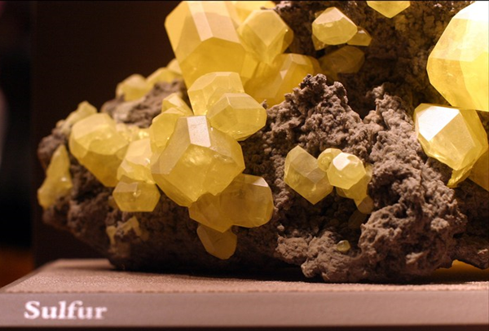
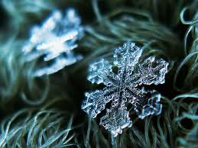
The paths for crystal formation
From gas to crystal
Desublimation (凝华), at which gas directly forms crystal at oversaturated vapor pressure or rather low temperature.
Near the crater （火山口）, crystals of sulfur, iodine, or sodium chloride are often produced by volcanic(火山岩) jets. Snowflakes and frostwork (雪花和霜花) are crystals that are directly crystallized by the cooling of water vapor.

Slide 5
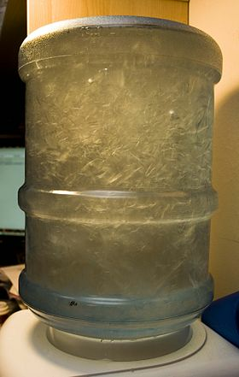
The paths for crystal formation
From liquid to crystal (crystallized from melt and solution)
1. Crystallization from melt
When the temperature is below the melting point, crystals begin to precipitate, that is, crystallization can only occur when the melt is supercooled. Water crystallizes as ice at temperatures below zero Celsius degree; molten metal cools below melting point and crystallizes into metal.
Condition：melt is supercooled
△T = T_{f} – T ；
T_{f} ：melting point；
T ：melt temperature；
△T： absolute supercooling.
Notes:
熔点或者结冰点时还不能结冰，和以前高中物理学讲的不一样！

Slide 6
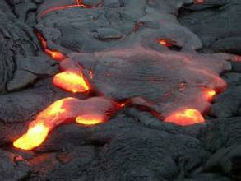
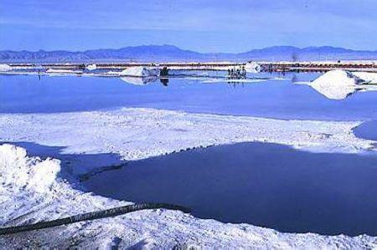
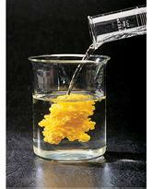
The paths for crystal formation
From liquid to crystal
2. Crystallization from solution
When the solution reaches supersaturation, the crystal can be precipitated. There are mainly three ways to achieve the state of supersaturation:
Lower temperature: The crystals of various minerals will be precipitated when the magma(岩浆) is far away from the source.
Solvent evaporation, such as evaporation of natural Saline Lake brines, crystallization of salt minerals.
The formation of insoluble substances by chemical reactions.
Oversaturated solution
△c = c – c_{eq}
△c：absolutely oversaturation;
c：solution concentration；
c_{eq} ：solubility
CaNO₃+Na₂CO₃=CaCO₃ ↓ + NaNO₃
Ca(OH)₂+H₃PO₄= Ca₅(PO₄)₃(OH) ↓ +H₂O

Slide 7
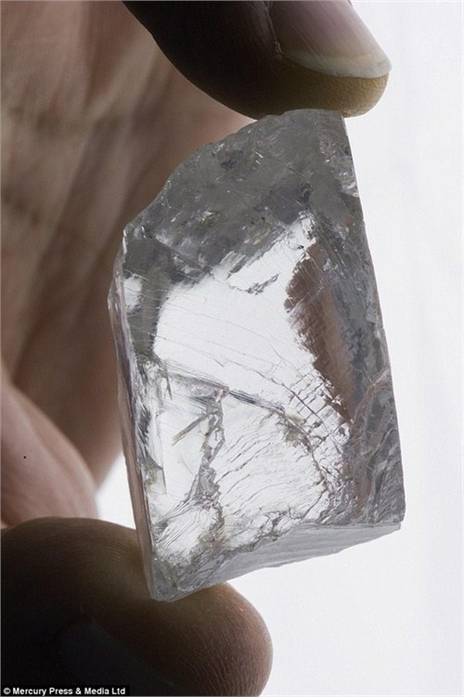
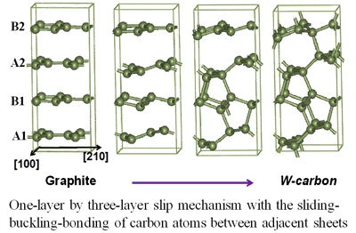
The paths for crystal formation
232 carat huge diamond
South Africa
From solid to crystal
石墨在高温高压下转化成金刚石
Polymorphic transformation(同素异形体转变）: It refers to the transformation that a crystal changes into a new crystal when the thermodynamic conditions change. They are the same in composition before and after the change, but the crystal structures are different.
Amorphous solid crystallization: lava（岩浆） flows rapidly from volcanic eruptions and is solidified into amorphous volcanic glass. This volcanic glass （火山岩玻璃） can gradually change to crystal after more than a thousand years.
Solid phase reaction crystallization: CaO+SiO₂=Ca₂SiO₃
(applied in steel making to remove Si and P impurities)
PRL. 106, 075501 (2011)
Monoclinic (insulator）
Rutile (metal)
MIT of VO₂
Notes:
1.最常见，自然条件下，石墨在地层中受地层高压和高温，形成金刚石。这种方式形成的金刚石纯度高、颗粒大，但是属于矿资源，开采成本高，产量有限，价格昂贵。
2.工业生产，通过高温、高压和催化剂的作用下生成。因为人造环境中要制备石墨转化为金刚石所需的高温高压非常困难，所以现有一般通过爆炸法制备。这种方法制备的金刚石，纯度低、颗粒小，但是产量高，价格低廉。
3.研究中的人造法。通过激光加热，二氧化碳还原法制备。这种方法正在研究，已经取得一部分进展，但是还没有引入工业生产。这种方法制备的金刚石纯度高、产量极高、价格低廉，但是颗粒较小，取得大颗粒金刚石还待研究。
金刚石所有的碳原子以sp3杂化与相邻四个碳原子以共价键连接，空间上按正四面体的分布
石墨的所有碳原子以sp2杂化与相邻三个碳原子以共价键连接，形成由六元环并列组成的平面，平面之间通过范德华作用力平行的叠在一起

Slide 8
Three stages for the crystal formation
The general process of crystal formation：
thermodynamic condition，nucleation, and growth
Three stages of crystal formation:
The medium reaches supersaturation or supercooling
Nucleation stage (homogeneous or heterogeneous nucleation)
Crystal growth stage
Notes:
热力学考虑（起始结束能量）？动力学考虑（过程）？

Slide 9
Analysis whether the ball can roll down the small hill from the thermodynamics and dynamics views
A
A
B
B
Momentum and energy are conserved

Slide 10
General rules for crystal growth
The faster the nucleation rate, the slower the crystal growth rate;
The slower the nucleation rate, the faster the crystal growth rate;
A large number of nuclei lead to the formation of small grains;
A small number of nuclei lead to the formation of large grains;
Note: the system is in a dynamic state during the crystallization process

Slide 11
（I）、Homogeneous nucleation (spontaneous nucleation)
Definition: crystal nuclei formed by their own atoms under conditions of supersaturation and supercooling
Embryo（晶胚）: an ordered structure with crystalline phases formed by lower energy molecules.
Nucleus（晶核）: The crystalline embryos that become the center of crystal growth.
Notes:
embryo
英 /ˈembriəʊ/

Slide 12
Energy changes during nucleation
Under a certain degree of supercooling, if there is a solid embryo in liquid, the energy in this region will change:
A certain volume of liquid changes to solid and its volumetric free energy decreases.
The surface free energy increases with the creation of a new liquid-solid interface.
The total amount of free energy change can be given as (nucleation energy):
, in which △G_{v} is the free energy change of the system when the new phase forms, and △G_{v}＜0. △G_{S} is surface energy of the interface between new phase and old phase, and △G_{S}＞0.
ΔG=ΔG_{V}+ΔG_{S}
Notes:
一定体积的液体转变为固体，体积自由能会下降，这个降低的自由能用来提供因为增加固液界面而需要的能量。

Slide 13
Driving force for crystallization
Crystallization is usually carried out at constant temperature and constant pressure, and the direction and the limit of the process can be judged by the criterion of free energy（自由能判据）:
The phase transition takes place in the direction of decreasing free energy.
Whether a small embryo develops or not after being present is determined by the free energy change with its volume.
ΔG_{system}<0, driving force increases
Δg_{system} >0, driving force decreases
Notes:
criterion
英 /kraɪˈtɪəriən/

Slide 14
Under a certain supercooling, ΔG_{V}＜0 and ΔG_{S}=σ*A, the surface tension σ is constant, and A is the surface area of the crystal nucleus.
Crystals always want to have the maximum volume and minimum interfacial area to ensure the minimum free energy.
Let ΔG_{v} and σ be constant, and the most favorable shape is a ball (considering an isotropic crystal model). Set the radius of the ball as r, then
ΔG = ΔG_{V} + ΔG_{S}
= V∙ΔG_{v} + A ∙ σ
= 4πr³ ΔG_{v} /3 + 4πr² σ

Slide 15
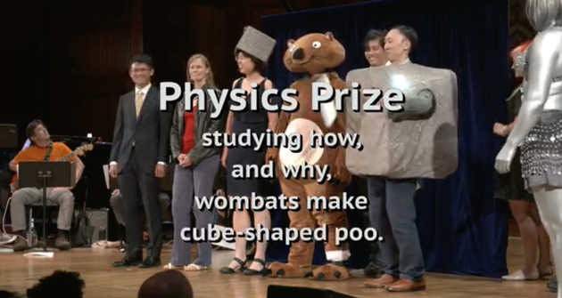
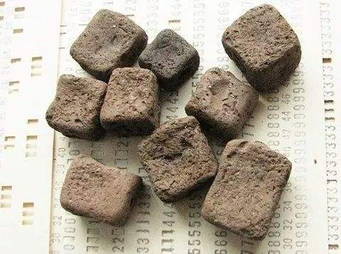
2019 搞笑诺贝尔物理学奖
获奖原因：研究了树袋熊排出方形粪便的方式和原因
树袋熊是已知的唯一一种会排出方形粪便的动物。佐治亚理工学院的一支研究团队利用几头树袋熊尸体，对这一现象展开了研究。结果发现，这种奇特的粪便与树袋熊肠道的形状和灵活性、以及树袋熊生活的环境比较干燥有关。该研究结论或许能帮助制造业改进方形产品的生产方法。

Slide 16
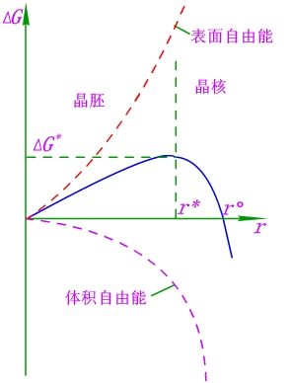
Classification of nuclei
r <r⁰
metastable nuclei
r =r⁰ (critical radius)
critical nuclei (embryo)
r > r⁰
stable nuclei→nucleation
Surface free energy
embryo
nucleation
Volume free energy
Notes:
Metastable nuclei
R =r* (critical radius) critical nucleus (embryo)
R R0 stable nuclei

Slide 17
In the system, if there is a crystal embryo with a radius of r...
Surface free energy
0 <r <r* ; r ↑, G_{System} ↑ ; disappearance probability > growing up probability
⇒ embryos can not grow up
r =r* (critical diameter); △G_{system}= △G _{max}= △G * (critical nucleation energy）；disappearance probability = growing up probability ⇒ Critical state
r* <r <r⁰; r ↑, G_{system}↓; disappearance probability < growing up probability ⇒ The embryo is not stable.
r > r⁰; △G_{system}<0; disappearance probability < growing up probability ⇒ The embryos can grow up as nuclei.
embryo
nucleation
Volume free energy
Grow up or disappear ？
Notes:
三条曲线的意义；这里从能量考虑晶胚是否长大; 注意是系统里面出现一个半径为r的核，然后考虑它长大或者变小，哪个过程G降低，朝降低的方向进行。
系统里面不管怎样，出现一个晶胚都是能量上考虑不合算，自由能增加；
晶胚是否长大取决于系统自由能随着r变化是增大还是减小；
注意上面右图不同的r对应的detaG都是根据液相为起点的；我们考虑的是在系统里面突然蹦出来一个半径为r的晶胚，然后看它时候能够长大。它的系统自由能变化是两个r对应的detaG之差；
在detaG 大于零的区域，晶核本身的形成是一个热力学不倾向的过程。

Slide 18
In the system, if there is a crystal embryo with a radius of r...
0 <r <r*
r ↑, G_{System} ↑ ;
disappearance probability > growing up probability
embryos can not grow up
r =r* (critical diameter)
G_{system}= G _{max}= G * (critical nucleation energy）；disappearance probability = growing up probability
⇒ Critical state
r > r*
r ↑, G_{system}↓;
disappearance probability < growing up probability
⇒ Embryos can grow up as nuclei.
Surface free energy
embryo
nucleation
Volume free energy
Notes:
三条曲线的意义；这里从能量考虑晶胚是否长大; 注意是系统里面出现一个半径为r的核，然后考虑它长大或者变小，哪个过程G降低，朝降低的方向进行。
系统里面不管怎样，出现一个晶胚都是能量上考虑不合算，自由能增加；
晶胚是否长大取决于系统自由能随着r变化是增大还是减小；
注意上面右图不同的r对应的detaG都是根据液相为起点的；我们考虑的是在系统里面突然蹦出来一个半径为r的晶胚，然后看它时候能够长大。它的系统自由能变化是两个r对应的detaG之差；
在detaG 大于零的区域，晶核本身的形成是一个热力学不倾向的过程。

Slide 19
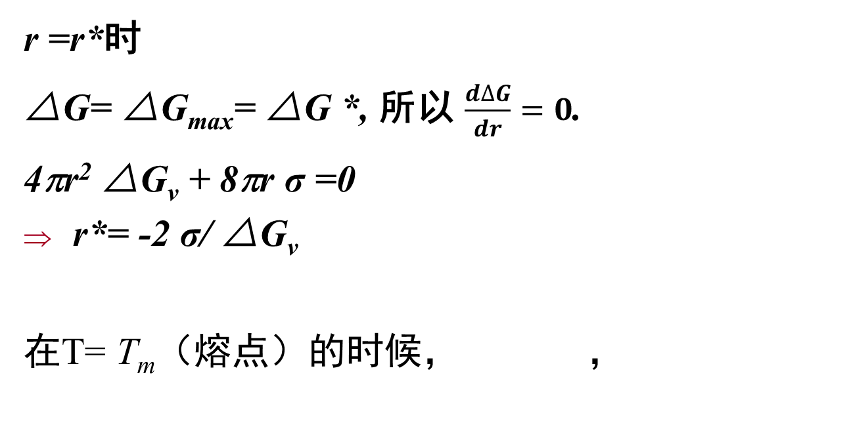





The relationship between r* 、∆G* and ∆T
So
G：Gibbs free energy
H：Enthalpy （焓）
S： Entropy （熵）
When T= Tm (melting point),
MP：learn and share the knowledge about G, H and S
,
Notes:
熔体中，r* 与ΔT 成反比，即过冷度ΔT 越大，r* 越小；ΔG*与（ΔT） ²成反比，过冷度ΔT 越大，ΔG*越小。
^{温度为熔点时，吉布斯自由能变化为零？}
derivation
英 /ˌderɪˈveɪʃn/
extremum
英 /ɪk'striːməm; ek-/
enthalpy
英 /‘enθ(ə)lpɪ; en’θælpɪ/ 焓

Slide 20
Critical nucleation energy ΔG * and nucleus surface energy ΔG_{S} *
，
∆G* = 4π(r*)²∙σ/3 = A* ∙σ/3
= ΔG_{S} */3
ΔG * = ΔG_{V} * + ΔG_{S} *
∆G* is equivalent to 1/3 ΔG_{S} *, which means that the free energy difference between solid and liquid (ΔG_{V} *) only supplies 2/3 surface energy ΔG_{S} * required for the critical nucleus formation.
Notes:
晶核的形成，液相到体相放热，自由能降低，负值；形成新的固液表面，自由能升高，需要吸热，正值。
在临界成核点，临界成核自由能为正值，系统能量升高，需要从环境中获得能量，吸热，大小为临界表面能增加的1/3。
体相放热的能量提供给表面形成需要的能量所需的2/3, 不够的1/3从环境中汲取。

Slide 21
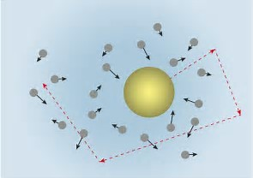
Critical nucleation energy ΔG * and nucleus surface energy ΔG_{S} *
ΔG * : critical energy required for the formation of the nucleus with radius r*; it equals 1/3 ΔG_{S} *.
Energy
This energy is complemented by the energy fluctuations of the system, and this is also the energy barrier that must be overcome by homogeneous nucleation.
Brownian
movement
http://xd.ku6.com/watch/7185429895035635084.html
How energy is transferred from ambient to the nucleus?
Notes:
The critical nucleation energy is equivalent to the G* nucleus of the surface energy of 1/3, which means that the free energy difference between solid and liquid was GV * only supply nucleation G * required surface energy of 2/3, the 1/3 energy to make up the energy of the system depends on the ups and downs, which is the energy barrier that must be overcome homogeneous nucleation.

Slide 22
1. roughly evaluate ΔG * and r* in one certain crystal formation; 2. compare the above values and kT 3. what’s your conclusion? 4. try to use above study to explain why it is hard to get crystal from solid-reaction or it requires quite high temperature or pressure.
Mini project releases
Notes:
Mini pro 作为作业？

Slide 23
The whole nucleation process requires to absorb energy from ambient （high T is better）. However it also need the condition of supercooling （low T is desired and at the same time decrease the require ΔG * ） to create an environment favoring for the alignment/period of atoms or molecules occasionally. （两个方面是相互冲突又统一）
Some thoughts

Slide 24
Embryos and nuclei formation in homogeneous nucleation?
* Taking crystallization in melts as an example
When the melt is in the vicinity of the melting point, although the overall atom arrangement is in the liquid state, in disorder, but the local area is not static. The atomic motion can cause local energy changing, so the instantaneous energy is fluctuated in the mean values. The corresponding structure (atomic arrangement) changes and can be as close to the crystal arrangement in the small part at some point.
The difference between the corresponding energy of the small part and the average energy (ΔG) is as mentioned above and as so called "energy fluctuation" and "structure fluctuation“.
Notes:
布朗运动;
系统里面永远有一定数量和大小的晶胚，是否长大，取决于晶胚大小和当前过冷度决定的临界成核尺寸的相对大小。

Slide 25
Embryos and nuclei formation in homogeneous nucleation?
The aggregation with regular atom arrangement will disappear if its size smaller than the critical size (also known as crystal embryos), and may grow up if its size larger than the critical size, that is, the nucleus.
The part that the energy of the nucleus with the certain size beyond the average system energy is called the nucleation work.
The smaller the supercooling, the smaller the difference between the free energy of solid and that of liquid; the larger the critical size, the higher the nucleation work, and the smaller the probability of occurrence. Nucleation can not be carried out in a limited time and space range if there is a rather small supercooling , i.e. nucleation requires certain supercooling.
Notes:
布朗运动;
系统里面永远有一定数量和大小的晶胚，是否长大，取决于晶胚大小和当前过冷度决定的临界成核尺寸的相对大小。

Slide 26
An infinitely large
critical nucleus
∆T=0
Critical nucleus
∆T
Notes:
布朗运动;
系统里面永远有一定数量和大小的晶胚，是否长大，取决于晶胚大小和当前过冷度决定的临界成核尺寸的相对大小。
分子平均平动动能E=3KT/2，因为局域对于某一个分子，与其他的分子碰撞获得的能量也在KT量级，因此局部能量起伏在KT量级

Slide 27
Three stages of spontaneous nucleation and growth of crystals
Stage I
System is in a supercooled state
Stage II
Energy fluctuations cause embryos
Stage III
Embryos larger than the critical size grow into crystals
Notes:
均匀成核（自发）的情况下，过冷度不够较难结晶；系统的起伏造成的晶胚尺寸难以大于临界尺寸成长为晶体。

Slide 28
（II）Heterogeneous nucleation (non spontaneous nucleation)
On the phase boundary surface, such as foreign particles, the container wall and the original crystal surface, the formed nuclei are called non spontaneous nucleation （非均匀成核、非自发成核或者异相成核）.
In nature: rain, snow, and hail (冰雹)
In industrial production: ingot（铸锭）, casting(铸件）, sugar making and salt making
Single crystal growth: the epitaxial growth of thin films and big crystals
MP: find some pics and videos for above cases of non-spontaneous nucleation
Notes:
很多时候，自发成核需要很高的过冷度，这对晶体的形成造成了极大的障碍。
抗旱或者举办活动需要人工降雨， 天空中撒入碘化银粉末作为成核中心。

Slide 29



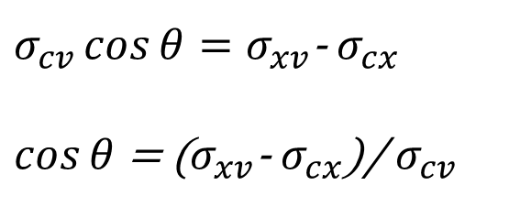
Heterogeneous nucleation on substrate surface
Features of nucleation on substrate surface:
Spherical cap nucleus;
Catalytic function;
Larger nucleation rate.
ϴ： contact angle of substrate and nucleus
c nucleus
v media
x substrate
σ_{cv} is the surface tension between nucleus and fluid media;
σ_{cx} is the surface tension between nucleus and substrate;
σ_{xv} is the surface tension between substrate and fluid media;
r is the radius of the spherical cap nucleus;
Notes:
At each point on the rim of the crown, considering the mechanical equilibrium, we obtain the following equation.

Slide 30
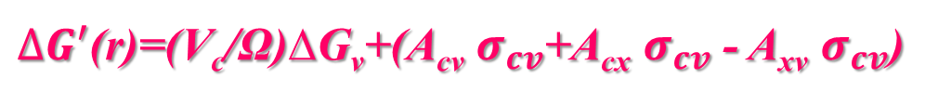
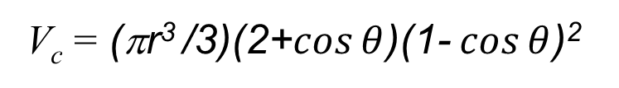
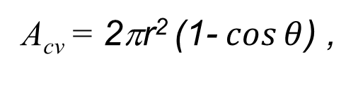
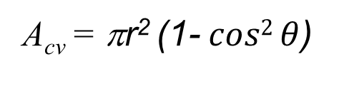
Heterogeneous nucleation on substrate surface
When the spherical cap nucleus is formed on the substrate, two interfaces are created: CV interface and CX interface. Original XV interface disappears.
∆G_{hetero}(r)
= V_{c}∙
+ A_{cx}σ_{cx} - A_{xv}σ_{xv} ）
A_{cx}=
So, we have
c nucleus
v media
x substrate
∆G_{hetero}(r)=∆G_{homo} (r) ∙ f(θ)
∆G_{homo} (r) the free energy change in homogeneous nucleation case;
f(θ) = (2-3cos θ +cos³ θ)/4, 0≤ f(θ) ≤1.
Notes:
Circle and crown
成核后，生成两个界面，一个是cv界面，一个是cx界面，消失一个xv界面。
C 晶核
V 介质
X 衬底

Slide 31
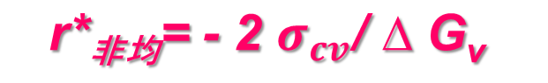
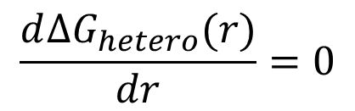
∆G_{hetero}(r) = ∆G_{homo} (r) ∙ f(θ)
$$\frac{d∆G_{hetero}(r)}{dr}=0$$
Similarly, from
we can get r*_{hetero} ,
r*_{hetero}
∆G*_{hetero}(r) = ∆G*_{homo} (r) ∙ f(θ)
It is found that
r*_{hetero} = r* _{homo}
∆G*_{hetero}(r) ≤ ∆G*_{homo} (r)
So heterogeneous nucleation is easier than homogeneous nucleation.
Homework: drive the series of formulas in heterogeneous nucleation.

Slide 32
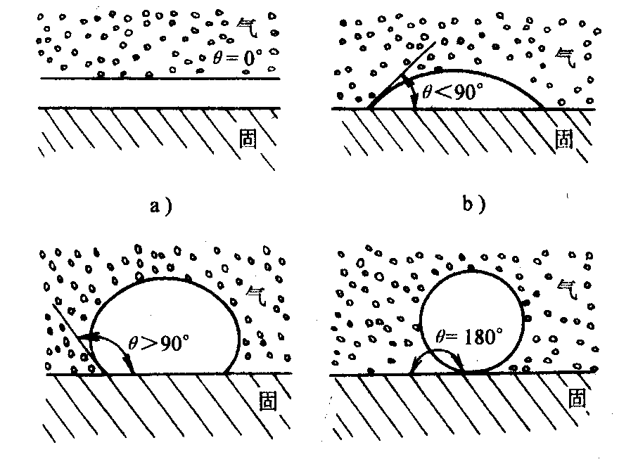
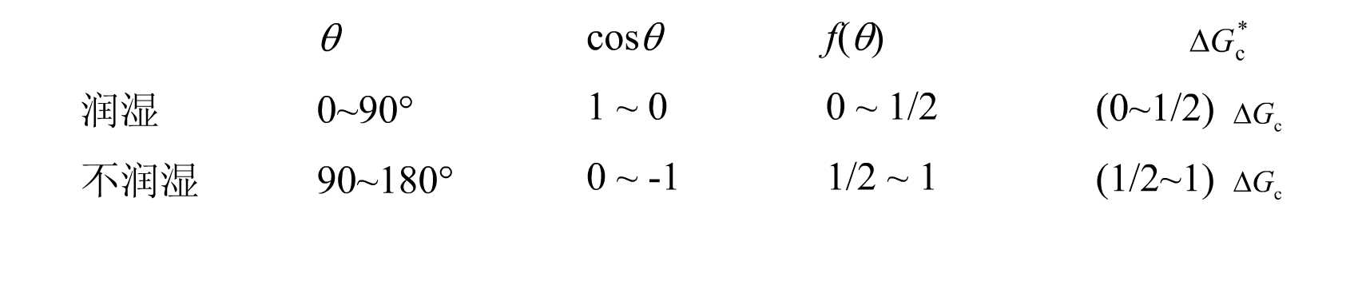
Influence of contact angle on nucleation barrier
θ=0，△G* _{hetero}＝0，
Impurity is the same material to nucleus；
180>θ>0, △G*_{hetero}<△G* _{homo},
Impurity promotes the nucleus；
θ=180, △G* _{hetero}＝△G* _{homo}，
Impurity does not work.
Gas
Gas
Solid
Solid
Gas
Gas
Solid
Solid
Wetting
Non-wetting
The smaller θ, the smaller the critical nucleation work for heterogeneous nucleation, and the smaller the critical supercooling required.

Slide 33
Surface energy and surface tension 1. concept, application and the relationship between these two concepts 2. values of common materials 3. Any relationship between surface energy and crystal growth?
Mini project releases
Notes:
Mini pro 作为作业？

Slide 34
The nucleation rate in homogeneous and heterogeneous nucleation progress.
Mini project releases
Notes:
Mini pro 作为作业？

Slide 35
III、Theoretical model of crystal growth
Once nucleus is formed, the crystal growth carries out at the crystal-liquid interface. That is, the atoms are piled up in accordance with the arrangement of the crystal structures to form crystals.
How crystals grow up?
What’s the dominant factors that determine the final morphology of crystals ?
There are five general crystal growth models/theories:
Layer growth model （科赛尔-斯特兰斯基模型）
Screw dislocation model
Curie Wolfe principle（居里-乌尔夫原理）
Bravais law （布拉维法则）
Periodic bond chain (PBC) theory
MP: Please find the scientists mentioned above and the oldest documents about the discovery of the five model/theories!

Slide 36
1．layer growth theory model
Nucleus positions on crystal surface:
Three side concave A (bonding in three directions, Type A site)
Two side concave B (bonding in two directions , Type B site)
Flat surface C (bonding only in one direction , Type C site)
C
B
A
Therefore, the best growth position is A, followed B. Position C is not a preferred place for crystal growth.
The most ideal way of crystal growth: firstly a row forms from position A, so that three side concave position disappear. New position A can be formed by attracting a mass point in position B. Then repeat the growth of rows to finally complete the layer growth.
Notes:
质点之间的价键力是短程力，简单起见只考虑最近邻

Slide 37
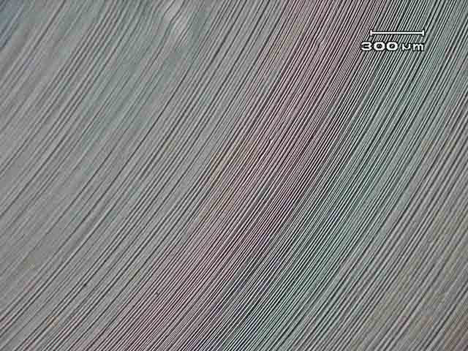
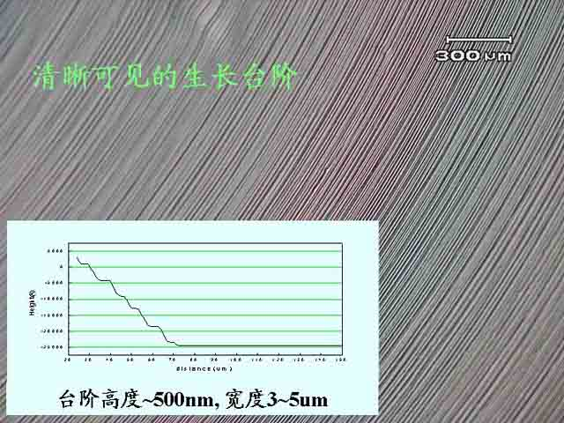
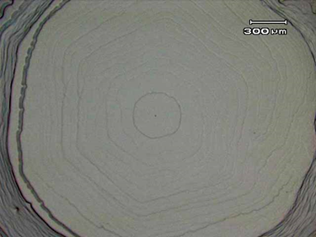
Simulation of crystal growth on smooth plane
Simulation of stepped growth
（see videos）
Examples of stepped growth:
concentric circles
Surface growth steps of silicon carbide crystal
Notes:
实际晶体生长不可能达到这么理想的情况，也可能一层还没有完全长满，另一层又开始生长了，这叫台阶状生长，最后可在晶面上留下生长层纹或生长阶梯。 阶梯状生长是属于层生长理论范畴的。

Slide 38
The idea of layer growth theory is:
Crystal growth is the process of pushing crystal surface outward layer by layer.
Shortcomings in layer growth theory:
When all the preferred growth positions (A,B sites) on certain interface are finished, if crystal continues to grow, it is necessary to grow a mass point on the flat surface, thereby providing new preferred growth positions. The mass point that grows on a flat surface is equivalent to a two-dimensional nucleus, which requires a rather high supersaturation. However, in practice many crystals can grow at very low supersaturation.
In order to solve the difference between the theoretical model and the reality, the mechanism of screw dislocation growth was proposed in 1949 by Frank(?).

Slide 39
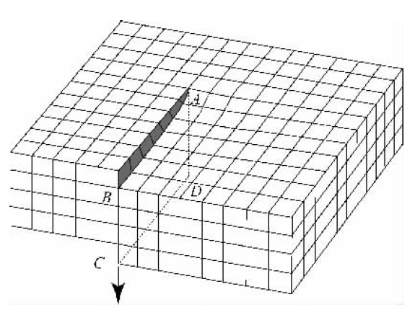
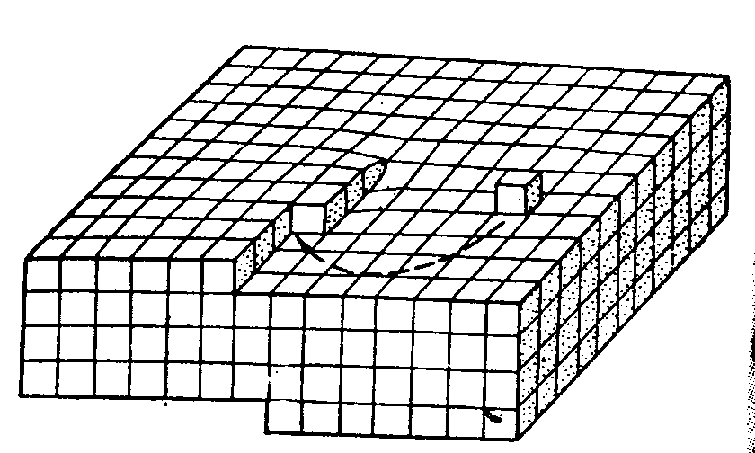
2．Screw dislocation growth mechanism
Type A sites
Schematic diagram of screw dislocation formation
The screw dislocation forms a step source on the crystal plane
The three side concave position A and the two side concave along line AB locating at the screw dislocation on the crystal growth interface can work as a step source for crystal growth and plays a catalytic role for the flat growth. The step source never disappears, so there is no need to form a two-dimensional nuclear, so that the crystal growth phenomena in a very low supersaturation can be successfully explained .
Notes:
A screw dislocation is a slip on a half plane of an ideal crystal.

Slide 40
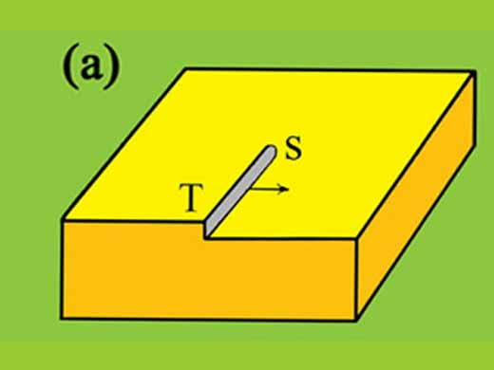
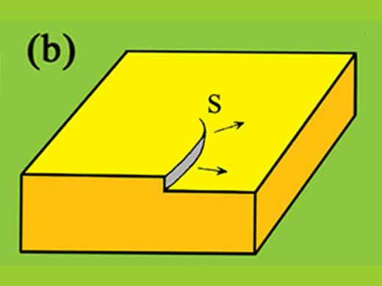
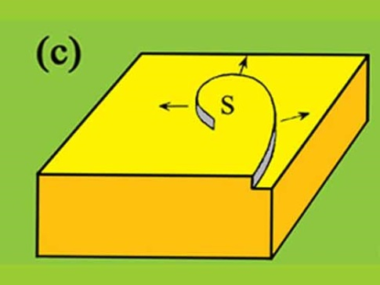
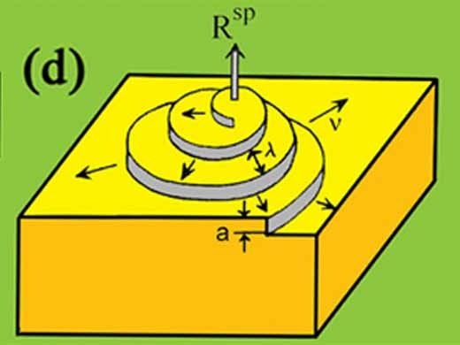
Screw growth model of crystal
In screw growth, the dislocation point in the crystal is the step source of crystal growth, and the growth form is different from the step type growth. As shown below, the simulation of spiral growth shows that, as crystals grow, spiral dislocations appear, and spiral dislocations continue to move forward.
Screw growth simulation (video)

Slide 41
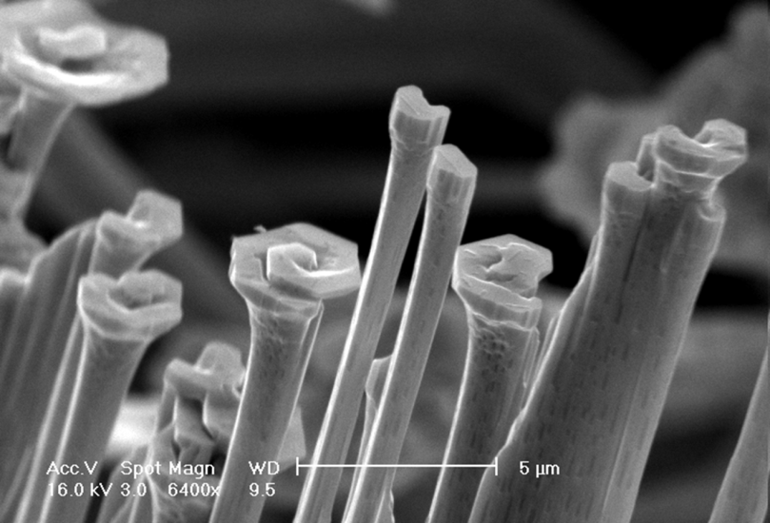
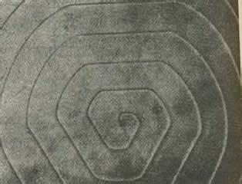
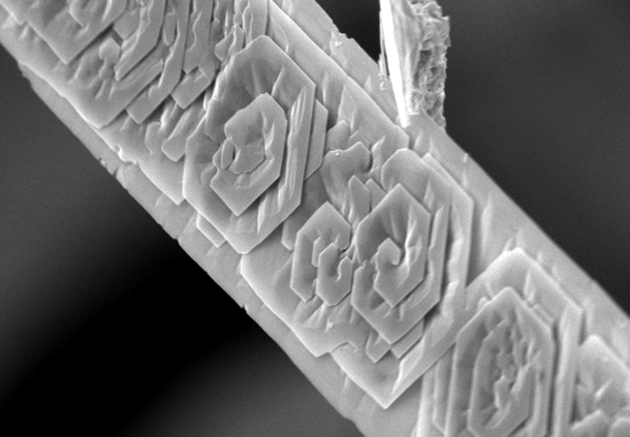
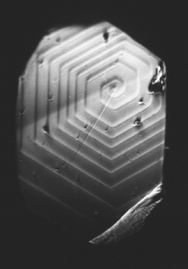
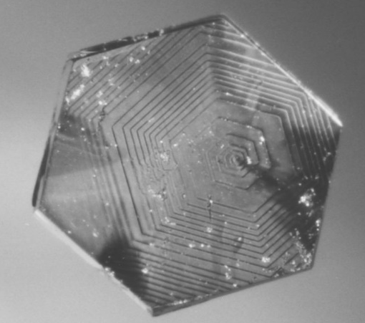
Examples
SiC crystals
ZnO microstructures
Graphite
MP: find three videos of screw growth?
Notes:
concentric circles

Slide 42
Expansive learning
ZnO microcrystals by different
growth mechanisms
N. Wang et al. / Materials Science and Engineering R 60 (2008) 1–51

Slide 43
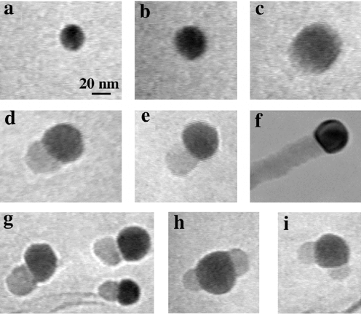
Direct Observation of Vapor−Liquid−Solid Nanowire Growth
J. Am. Chem. Soc., 2001, 123 (13), pp 3165–3166

Slide 44
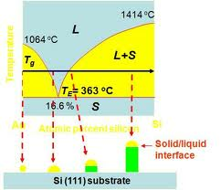
Metal-assisted Vapor-Liquid-Solid (VLS) Growth
Expansive learning
1
S_{Au}
Temperature
2
S_{Au} + L_{Au@Si}
1
2
3
4
5
Si % constant
S+L
3
L1_{Au@Si}
Si % increases
Au
Atomic percent silicon
Si
SiH₄
4
L2_{Au@Si}
Si % constant
5
L2_{Au@Si}+S_{Si}
Homework: How about the progress for green line?
Notes:
Eutectic point 共晶点
升温后保持在一定温度，金颗粒没有融化，因为没有到熔点。
2. 硅烷开始在金颗粒表面分解，Si和金形成合金。合金的比例与温度平行线与相界面的交点处所对应。
3. 硅烷继续和金形成合金，直到所有的固态的金都和Si形成液态的合金。合金的比例保持不变。
3-4. 硅烷继续溶解到合金里面，合金中Si的比例一直上升到点4。
4. 这个时候液态合金中的Si比例继续增加，形成过饱和状态。按照相图是不能容纳Si，整个液态合金的比例必须保持不变。所以多的Si会从在过饱和的时候成核，然后析出。一旦析出，那么就不断有硅在固液界面析出来。生长成为纳米线。

Slide 45
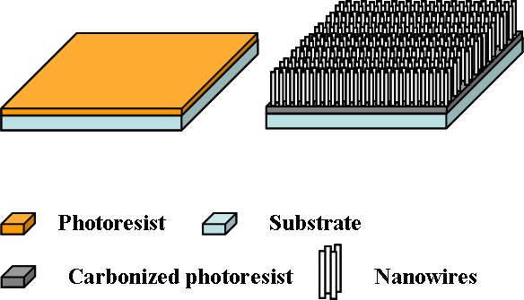
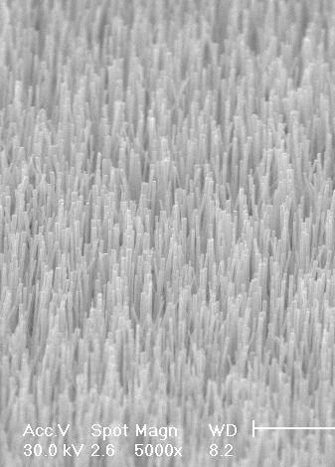
Self-catalytic VLS Growth
Growth process
PR is carbonized
Zn,O_{2,} ZnO
(Zn, C and Si are of immiscibility)
Local carbon thermal reaction for
the extraction of Zn droplets
Zn,O_{2,} ZnO
C(s)+ZnO(g)←→Zn(l)+CO₂/CO(g)
Self-catalytic
vapor liquid solid (VLS) growth
With Zn-terminated (0001) surfaces as the fast growth front.
Zn(l)+O₂←→ZnO
Zn catalysts are consumed due to
high temperature

Slide 46
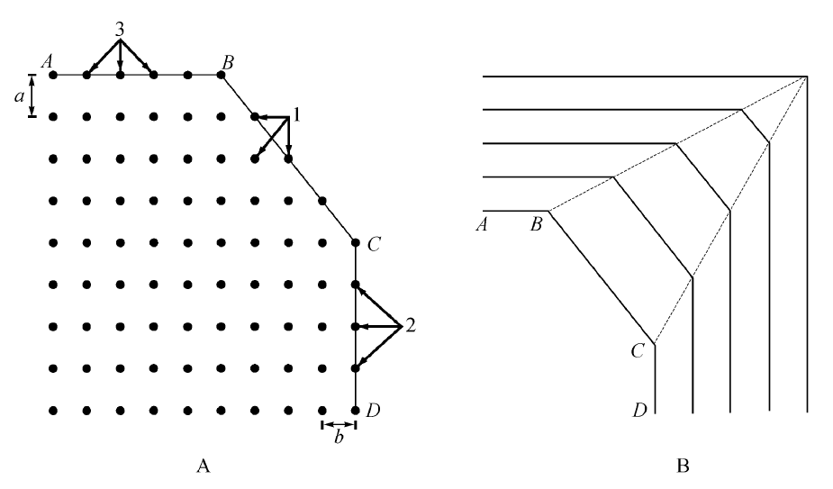
3. Bravais Law (布拉维法则)
The exposed facets on ideal crystals are often parallel to the nets with large net density (net spacing is also large).
The relative growth rate of crystal faces is inversely proportional to the density of the nodes on the net surface. (晶面法向生长速度和该晶面的面间距/面密度成反比）
Why?
The larger net density →the larger net spacing → the smaller the attraction to growth particles → the slower the growth rate normal to the net → The net/facet retains.
And vice versa！
h₁
h₃
h₂
Sketch map for Bravais law
Net density（D）
D_{AB}>D_{CD}>D_{BC};
Net spacing（d）
d_{AB}>d_{CD}>d_{BC};
Notes:
在某一个方向上的生长不能超过其对应平行线（方向速度限制）;
这个法则也有缺陷的地方，有同学认为密度越高，对外来原子的吸附能力也越强。。。；我认为每个原子对于发现方向只有一个不饱和的悬挂键，加上原子分子间作用力是短程力，所以面间距起到的作用更加重要。。。

Slide 47
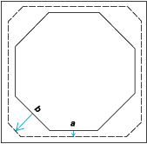
Advantages and shortcoming of Bravais law
It can be used to explain the phenomena that why the facets of big crystals are few and simple, and the facets of small crystals are various and complex.
Bravais law is based on space lattice constructed by the abstract nodes instead of real crystal structures. Therefore, in some cases, there may be some deviations from the actual situation.
Only consider crystals and ignore the practical growth conditions.
Fast growth speed
Slow growth speed
Notes:
为什么大晶体上的晶面种类少而且简单，小晶体上的晶面种类多且复杂。--》长没了

Slide 48
Exercise
Please give the final crystal morphology of nuclei below. Red color indicates facets with fast growth speed at their normal directions.
Notes:
为什么大晶体上的晶面种类少而且简单，小晶体上的晶面种类多且复杂。--》长没了

Slide 49
4. Periodic bond chain (PBC) theory：
Hartman (哈特曼) and Perdok (柏多克) thought that there are a series of strong periodic bond chains repeating in crystal structure. These chains have the same periodic repetition characteristic as those of mass points in crystals. These chains are called periodic bond chains (PBC for short).
It is found that crystals always grow parallel to the PBC chains and the growth speed along the direction with the strongest bonding force is the fastest. Based on this consideration, the crystal facets appearing in the process of crystal growth can be divided into three types, that is F, S and K, respectively .
Notes:
该理论从晶体结构的几何特点和质点能量两方面来探讨界面的生长发育。哈特曼和柏多克等认为在晶体结构中存在一系列周期性重复的强键链，其重复特征与晶体中质点的周期性重复相一致，这样的强键链称为周期键链（periodic bond chain，简写为PBC），晶体均平行键链生长，键力最强的方向生长最快，基于这种考虑，可将晶体生长过程中所能出现的晶面划分为三种类型，分别为F，S和K。
F面，或称平坦面，有两个以上的PBC与之平行，网面密度最大。质点结合到F面上去时，只形成一个强键，晶面生长速度慢，易于形成晶体的主要晶面。
S面，或称阶梯面只有一个PBC与之平行，网面密度中等。质点结合到S面上去时，形成的强键至少比F面多一个，晶面生长速度属于中等。
K面， 或称扭折面，不平行任何PBC，网面密度最小，扭折处的发现方向与PBC一致，质点极其容易从扭折处进入晶格，晶面生长速率快，时易消失的晶面。 因此，晶体上F面为最常见且发育较大的面，K面经常缺失或罕见。

Slide 50
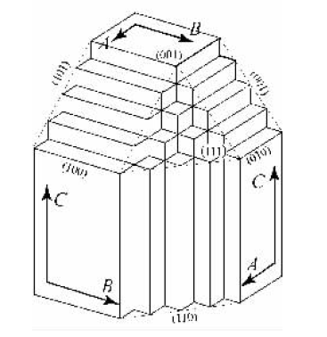
Three types of growth facets：
F surface (flat surface, two PBC), easy to retains on crystals.
S surface (ladder surface, one PBC) may be retained or not retained.
K surface (kink surface, No PBC) is difficult to retain on crystals.
C
A, B and C are three PBC directions
B
A
Notes:
F面，或称平坦面，有两个以上的PBC与之平行，网面密度最大。质点结合到F面上去时，只形成一个强键，晶面生长速度慢，易于形成晶体的主要晶面。
S面，或称阶梯面只有一个PBC与之平行，网面密度中等。质点结合到S面上去时，形成的强键至少比F面多一个，晶面生长速度属于中等。
K面， 或称扭折面，不平行任何PBC，网面密度最小，扭折处的发现方向与PBC一致，质点极其容易从扭折处进入晶格，晶面生长速率快，时易消失的晶面。 因此，晶体上F面为最常见且发育较大的面，K面经常缺失或罕见。

Slide 51
5. Curie Wolfe principle
(the minimum surface energy principle)
When the sum of surface energy of a crystal is minimal, the crystal morphology is the most stable. (The equilibrium shape of crystal growth has the minimum surface energy)
Wolfe also pointed out that when the surface energy of a crystal reaches the minimum value with a fixed crystal volume, the distance (m) between the crystal faces and the center of the crystal is proportional to the surface tension (or the surface energy σ) of each crystal surface.
m₁: m₂: m₃:··· = σ₁: σ₂: σ₃:···
that is, the growth rate normal to a crystal face is proportional to its specific surface energy.
Note: the surface energy of a crystal will change with environment medium. Crystals in different media have different crystalline forms.

Slide 52
Advantages:
Curie Wolfe principle considers the crystal growth from the aspect of surface energy, which is determined by two key factors: crystal and media. However, in practical crystals always can not reach their equilibrium morphologies, thus affect the application of this principle.
Exercise：
Think about the relationship between the mentioned five crystal growth models/theories.
Notes:
表面能大小由什么决定？

Slide 53
IV、External factors affecting crystal growth
The internal factors (structure, component and defects) are the fundamental reasons determining crystal morphology during growth;
However, the external environment also has a great influence on crystal morphology;
Crystal morphology may vary when crystals grow in different conditions.
Temperature; impurities; viscosity（黏度）;
nucleation rate; vortex (涡流) etc.
All these external factors affect crystal growth through internal factors.

Slide 54
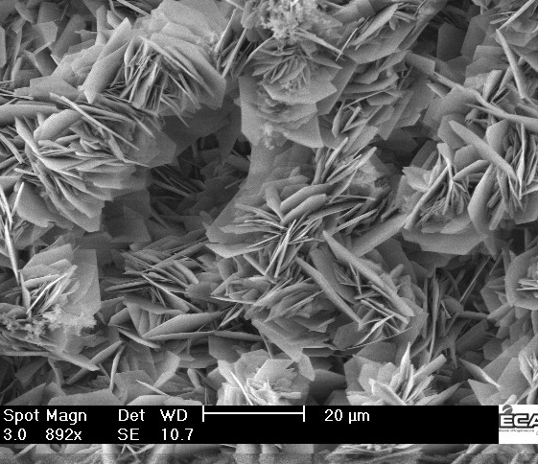
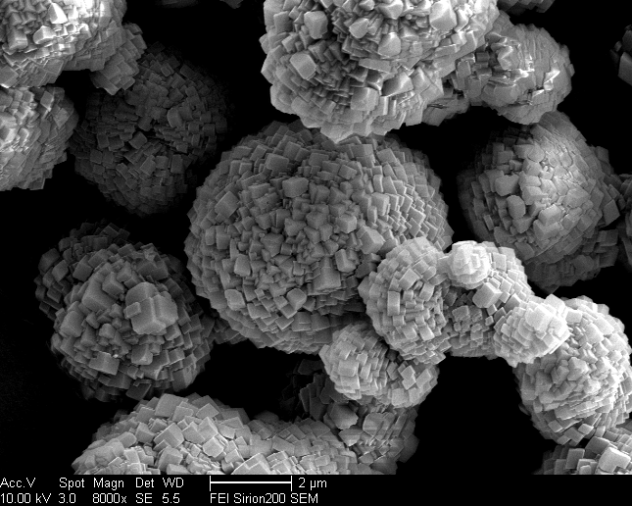
Temperature
Under different temperature conditions, the relative growth rate of different crystal faces of the same crystal will change, and thus affects the final growth morphology.
Left：High Temperature； Right：Room Temperature
Crystal morphology of calcite (CaCO3)

Slide 55

Impurity
The adsorption of impurities will change the specific surface free energy of crystal surfaces, which results in the change of the growth rate of crystal surfaces..
No impurity in
growth solution
Small amount of
boric acid in growth solution
NaCl crystal

Slide 56
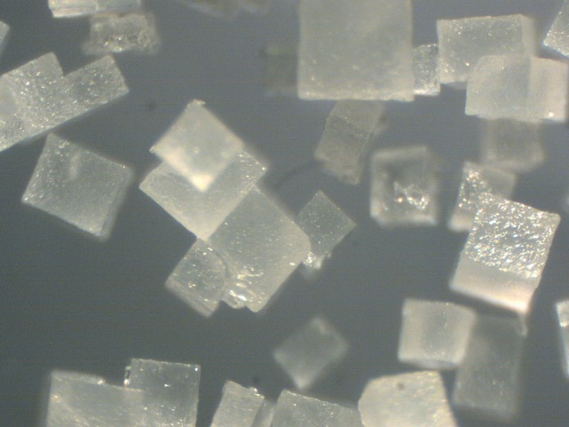
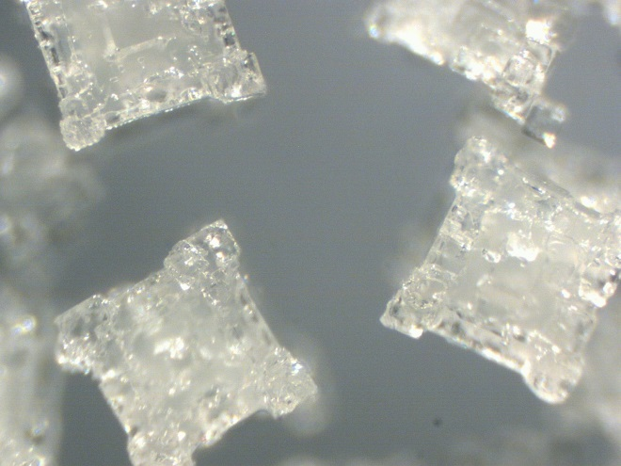
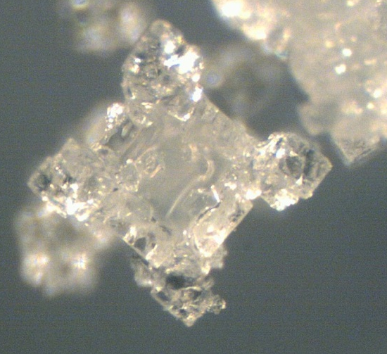



Medium viscosity
Medium viscosity can largely affect the transport and supply of materials. Because the edges and corners at the top of crystals can easily received solute, the growth at these position is faster; There is quite slow growth or almost no growth at crystal surface center, resulting in the formation of skeleton crystals（骸晶）.

Slide 57
Relative concentration of components
More Al₂O₃
More Y₂O₃
Y₃Al₂[AlO₄]₃ crystal morphologies

Slide 58
Vortex (涡流)
In the process of crystal growth, with the increasing adhesion of surrounding solute to crystal and heat release increased from crystal growth , the solution around crystal ascends due to the temperature increases and the density decreases around crystal under the action of gravity. The heavy cold solution far away from the crystal thus flows to crystal, so as to form a vortex. A vortex that causes the growth of crystals to be unevenly supplied (生长物料供应不均匀）.
Hot
Cold
The impact of vortex on crystal morphology

Slide 59

Good messages can produce beautiful water crystals Photo/Dr. Katsuo Jiang, IHM research institute, Japan 照片／日本IHM研究所江本勝博士
FAKE
Love and thanks
I want to kill you
The ice crystal with the water reading different characters
Notes:
联合国总部 UN headquarter

Slide 60
Superstition (迷信）? No, it is still some science. Different kinds of music have various frequencies.
「田园交响曲」
「离别曲」
「重金属音乐」
愉快！
Happy
凄然心碎…
Sad
解体？
Broken
The ice crystal with the water hearing different music

Slide 61


Ultrasound is applied to the synthesis of nanometer materials
Direct precipitation
Sonochemistry
Largely improving the controllability and homogeneity
MP：sonochemistry, principles of equipment and the crystal growth examples

Slide 62
五、 Growth technique of crystals
Czochralski (CZ) method (提拉法)
Flame fusion method (焰熔法)
Hydrothermal method (水热法)

Slide 63
CZ Method (提拉法)
In CZ method, raw material is heated and melted in a crucible and crystal seeds contact the melt surface and are used to pull out single crystals.
Between the interface of seeds and melt, atoms or molecules are rearranged with the decrease of temperature and gradually solidified as single crystals.
This method is used primarily for the growth of high quality crystals.
Semiconductor: single crystal Si, single crystal Ge;
Crystals for solid state lasers: Ruby (Al2O3) and neodymium（钕） doped yttrium aluminum garnet (Nd:Y3Al5O12)（榴石）
Piezoelectric materials: barium titanate (BaTiO3), lithium tantalate (LiTaO3);
Pyroelectric materials: lithium niobate (LiNbO3), used for infrared detection and infrared photography.

Slide 64


Sketch map of CZ method
Insulation material
Crystal
Window
Iridium crucible
Refractory material
Radio-frequency coil

Slide 65

Sketch map for single crystal Si grown by
CZ method

Slide 66


Crystal Production Equipment by CZ method

Slide 67

Flame fusion method (焰熔法)
Flame fusion is the method of growing a single crystal from a melt. The powder of the raw material is melted by a high temperature oxyhydrogen flame. The droplet is cooled in the process of falling, and is gradually consolidated on the seed crystal to form a crystal.
Equipment and production process (Taking corundum as an example)
Combustion temperature: 2200 ℃ Celsius (corundum melting point is 2050 ℃).
Crystal growth rate: l cm/h.

Slide 68


In the process of crystal production by flame fusion method
End of crystal growth

Slide 69



End of production process

Slide 70
Hydrothermal method
(水热法)
Under high temperature and high pressure conditions, the components are dissolved in the hot zone of the closed autoclave and then crystallized on the seed crystals at cooler locations.

Slide 71


Slide 72
Quiz 2.1
What are the three stages of crystal growth?
The two growth models of crystal growth and their relationships?
The internal factors that affect growth morphology of crystals.
Except the three growth methods for single crystals, please find at least five growth methods.

Slide 73
Homework
Search papers and find at least one example for each external factor that affects crystal growth. Write a short review to explain how these external factors affect crystal growth based on these examples.
Find other external factors that affect crystal growth (not listed in the lecture)

Slide 74














UC-berkeley

Slide 75


加州大学伯克利分校（University of California, Berkeley），简称“伯克利”，英文简称“Berkeley”或“Cal”，坐落在美国旧金山湾区的伯克利市，是世界著名研究型大学和最顶尖公立大学，在学术界享有盛誉，位列2020年U.S. News世界大学排名第4位、世界大学学术排名第5位。
2020年诺贝尔奖，加州大学伯克利分校和斯坦福大学可以说是平分秋色，各拥有两名诺奖得主。
Reinhard Genzel
Jennifer Anne Doudna
物理奖-黑洞研究
化学奖-CRISPR基因剪刀
Notes:
2020年诺贝尔物理学奖再次颁发给天体物理学，近四年来已经第三次颁给天体物理学，而黑洞研究作为天体物理领域的最重要进展获得诺奖也是众望所归。
这三位科学家，Roger Penrose表明，相对论的一般理论导致了黑洞的形成；Reinhard Genzel和Andrea Ghez发现，一个隐形且极重的物体控制着我们银河系中心恒星的轨道，超大质量黑洞是目前唯一已知的解释。
诺贝尔化学奖被调侃为“理科综合奖”，不少人的获奖成就并非出自传统的化学研究，而是涉及生物学、物理学等多重学科。今年的化学奖就是颁给了两位生物学家，两位科学家发现了基因技术中最犀利的工具之一：CRISPR/Cas9基因剪刀。
使用这项基因技术，研究人员可以非常高精度地改变动物、植物以及微生物DNA。这项技术对生命科学产生了革命性的影响，正在为新的癌症疗法做出贡献，并可能使治愈遗传性疾病的梦想成真。

